Slide 1

Toronto Crime and Demographics
Jaehong Kwon
XiongFei (Frank) Shi
Feng Wang
Olive Sun
Neha Nayeem

Slide 2


Project Description
As residents of Toronto, we want to
Gain insights on Toronto Safety and Crime Rates for different neighborhood
Further analyze and visualize different type of charts interactively

Slide 3
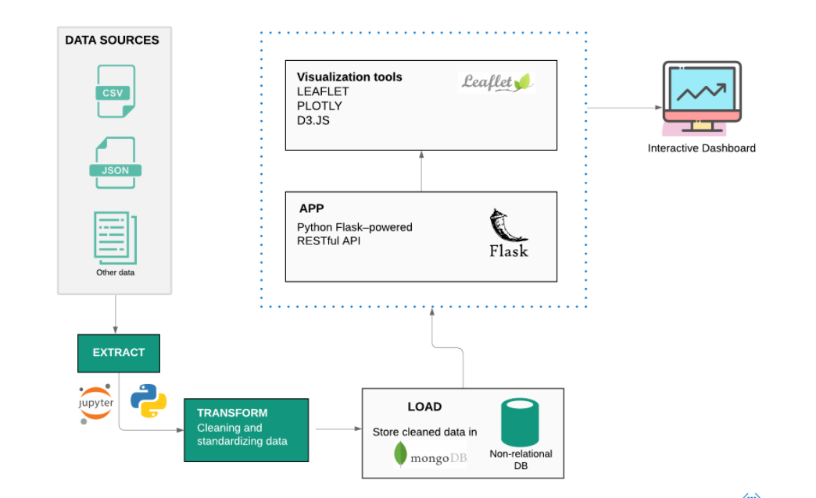

Process and Decision Making

Slide 4
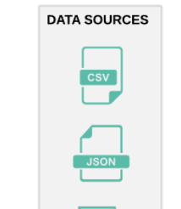
Data Sources
Toronto Police Open Data
Toronto Open Data - Neighbourhood Profiles
Toronto Neighbourhoods GeoJson
Notes:
RESEARCH QUESTIONS
a. What are the most common / least common crimes in Toronto?
b. What are the total number of crimes in 2014-2019 and are there any trends?
What time of the year the frequency of crime is highest?
Relationship between crime and different seasons
Relationship between crime and time of the day
Crime by neighborhoods
Which neighborhoods experience the highest and lowest crime rates in Toronto?
How close were police stations to where the crime occurred?
Where in Toronto are Auto Theft, Break and Enter and Robbery likely to occur?
In what kinds of properties do the following crimes occur? (house, commercial, apartment, etc)
Break-and-enter
Robbery
Assault
Is crime decreasing/increasing over the years?
Relationship between crime and current economy

Slide 5

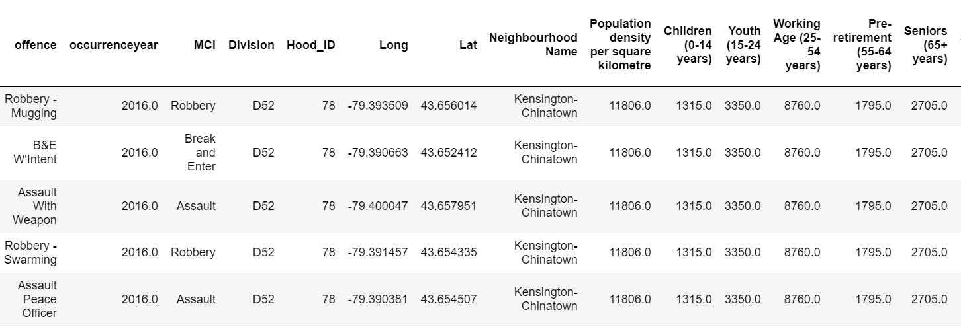
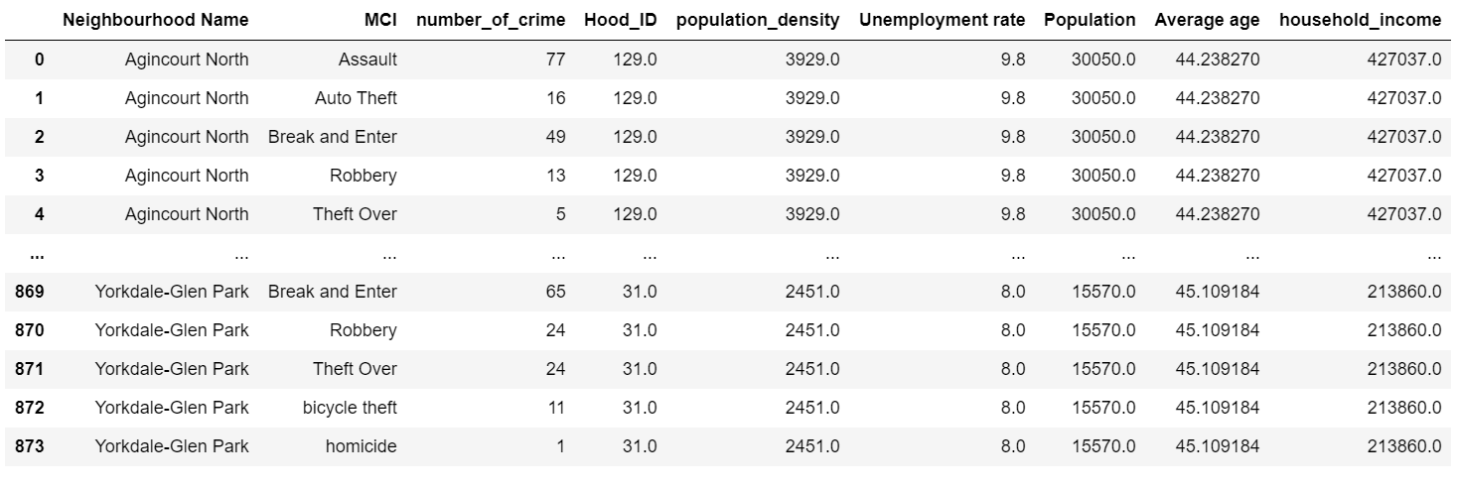
Data Extraction and Transformation

Slide 6
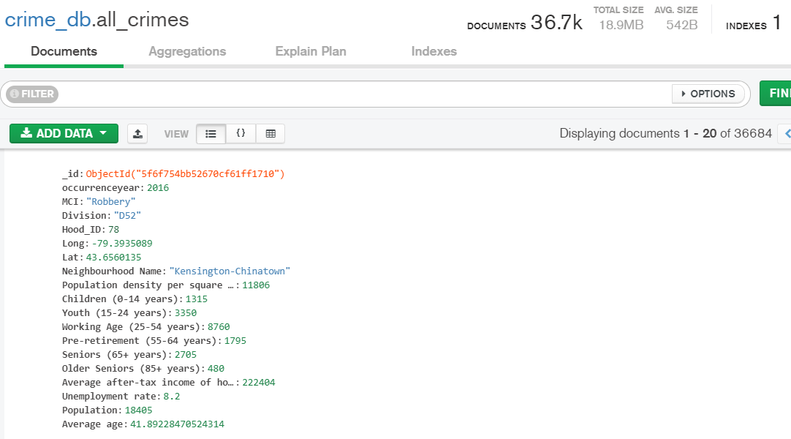

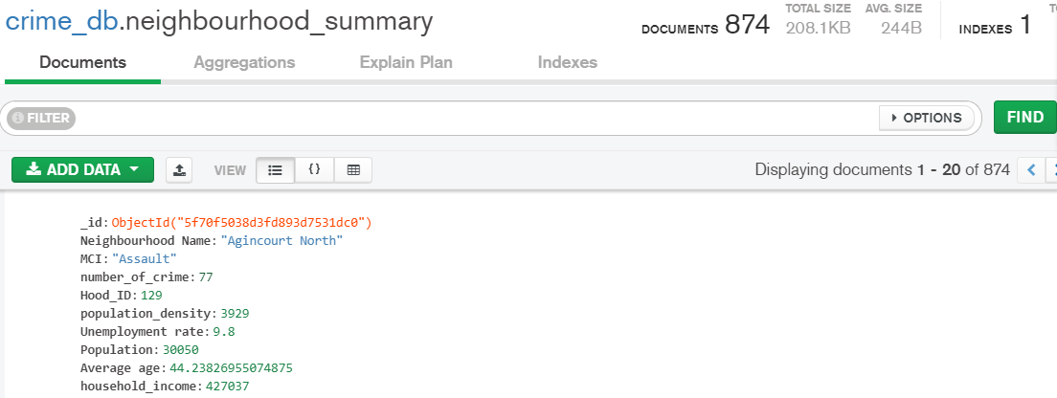
Load

Slide 7
Flask Application
/
Dashboard page
/api/v1/raw-data
Json data for the interactive map
/api/v1/neighbourhood-summary
Json data for the bar chart and scatter chart
Notes:
Our Flask app connects to the mongo database and pulls in data, implements further transformation and hosts our API endpoints as follows:
1. The root endpoint directs the user to the `index.html` page which holds the visualization dashboard.
2. This endpoint pulls data as is from the mongo database and returns a JSON format that is used by our code `logic-map.js` to create an interactive map.
3. This endpoint pulls another collection from the mongo database that holds neighbourhood demographics, used for plotting in `logic.js`. Before the data is returned in JSON format, some additional transformation is completed to get the data in exactly the way we need it for plotting.

Slide 8








Visualization Tools
Our visualization dashboard consists of the following technologies:
HTML/CSS/JS
Bootstrap
Mapbox
Leaflet
D3
Plotly
Leaflet

Slide 9

Q&A

Slide 10

Thank you, next!

